Slide 1


Polyglot Persistence and Big Data
Al.I. Cuza University of Iași
Faculty of Economics and Business Administration
Department of Accounting, Information Systems and Statistics
Document Databases. MongoDB
By Marin Fotache

Slide 2
Agenda
Introduction to MongoDB
Basics of Document Database Model: JSON
Getting Started with MongoDB
Install and launch MongoDB
MongoDB clients
Basic operations
Creating and updating collections
Insert documents: insert(), save()
Update documents: save(), update()
Updating scalar attributes
Updating arrays
Updating sub-documents

Slide 3
Agenda (cont.)
Basic queries in MongoDB
find() and findOne(), selection operators
Sorting, limiting and slicing results
Accesing arrays elements
Indexes
Cursors
Dealing with related collections
Aggregation Framework
Database modeling in MongoDB
Importing relational data in Mongo through R (changing the data structure)
Case study: sales

Slide 4
Install MongoDB (server) and Robo3T (client)
How to install MongoDB 4.4.1 on Windows 10 (2020)
https://www.youtube.com/watch?v=UJQiGBDKXY0
How to Install MongoDB on Windows 7/8/10 | How to Install Mongo Compass as separate installer (2020)
https://www.youtube.com/watch?v=MgZrTK595kM
Learn how to set up a MongoDB (2020)
https://medium.com/@fabianbosler/install-mongodb-d5cc6f6191a4
Install MongoDB (Community Edition)
https://docs.mongodb.com/manual/installation/
Install Robo 3T to Windows 10 (2020)
https://www.youtube.com/watch?v=wl7ccAXwnqg

Slide 5
Free tutorials on MongoDB
MongoDB Tutorial for Beginners (Bogdan Stashchuk) - playlist
https://www.youtube.com/playlist?list=PLWkguCWKqN9OumKjTAzbpsFFBBeem23xQ
MongoDB Tutorial (TutorialsPoint)
https://www.tutorialspoint.com/mongodb/index.htm
Getting Started with MongoDB – An Introduction
https://studio3t.com/knowledge-base/articles/mongodb-getting-started/
MongoDB Tutorial
https://www.qhmit.com/mongodb/tutorial/

Slide 6
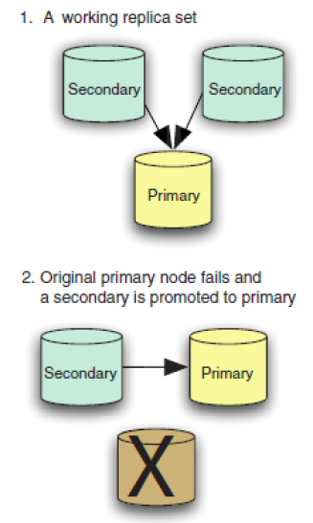
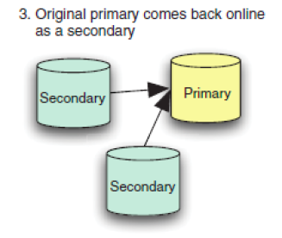
Simple Topology of MongoDB
Source: Banker, 2015

Slide 7
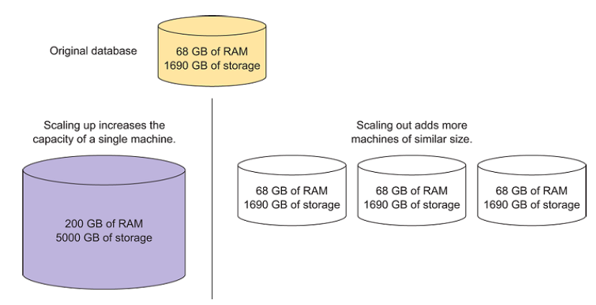
Vertical (left) vs. Horizontal Scaling
Source: Banker, 2015

Slide 8
More on MongoDB architecture
Scalability through Replication and Sharding (2019)
https://www.mongodb.com/presentations/scalability-through-replication-and-sharding

Slide 9
Basics of Document Database Model: JSON
Basics of Document Database Model: JSON
Databases
Collections
Documents
Attributes/Fields:
Key-value pairs
ObjectId
Scalars
Arrays
Sub-documents

Slide 10
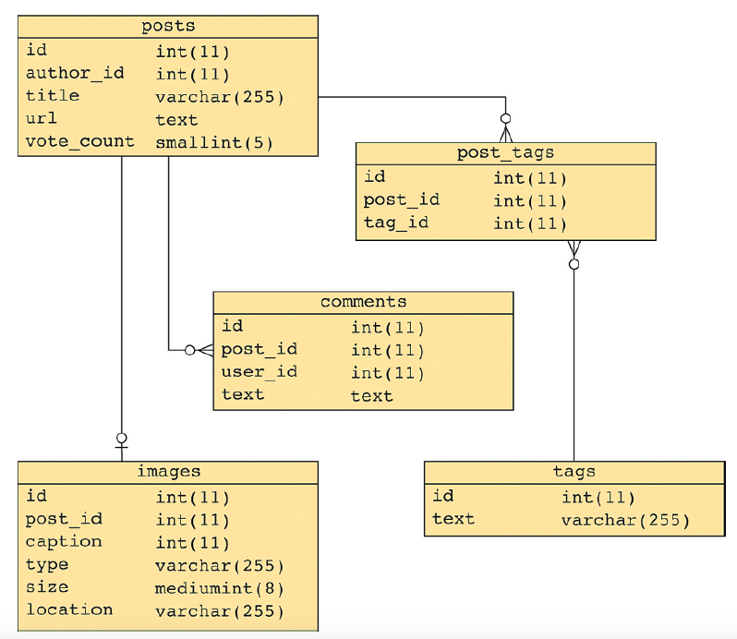
Entries on a Social News Site - relational
Source: Banker, 2015

Slide 11
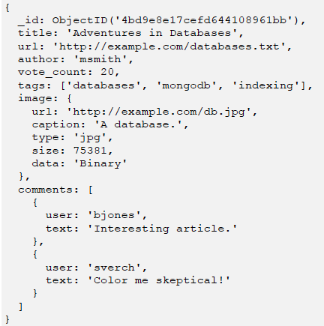
A Document Associated to an Entry on a Social News Site
Source:
Banker, 2015

Slide 12
Working with MongoDB
Basic client for MongoDB: MongoShell (Java Script)
http://docs.mongodb.org/manual/reference/mongo-shell
The best free MongoDB client we have found (so far) is Robomongo/Robo 3T
https://robomongo.org/download
GUI Client provided by MongoDB: Compass
https://www.mongodb.com/products/compass
We will use Robo3T (except for the scripts, since Robo3T cannot execute multiple commands at once)

Slide 13
Working with MongoDB (cont)
Topics covered in script 02-01_MongoDB – Introduction.js
Connect to MongoDB database
Some basic operations:
Getting help: db.help()
List databases: show dbs, show databases
Show current database: db
Display information/stistics about current database: db.stats()
Set the current DB: use
Display collections in current database: show collections
Display available commands: help()

Slide 14
Working with MongoDB (cont.)
Topics covered in script 02-01_MongoDB – Introduction.js (cont.)
Remove collections: drop()
Create collection:
createCollection()
insert(), insertOne(), insertMany()
save()
Display document(s) in collection:
findOne()
find()

Slide 15
Managing collections in MongoDB (Topics covered in script 02-02_MongoDB - Managing collections)
Basics of update(), save() and findAndModify()
Operators $set and $unset
Variables, functions and loops
Operator $inc
Managing arrays:
Operators $push and $each
Operator $addToSet

Slide 16
Managing collections in MongoDB (cont.) (Topics covered in script 02-02_MongoDB - Managing collections)
Managing arrays: (cont.)
Operator $pull
Operator arrayAttribute.index.property
Operator arrayAttribute.$.property
Updating sets of documents
"Upserts"

Slide 17
Basic queries in MongoDB (Topics covered in script 02-03_MongoDB - Queries (1), cursors)
Details about find() and findOne():
Selection
Projection
Limit
Skip
Basic operators for selection:
$ne, $not, $nin
$in
$or, $and
$gte, $gt, $lte, $le
$exists
null
$all

Slide 18
Basic queries in MongoDB (cont) (Topics covered in script 02-03_MongoDB - Queries (1), cursors)
Sorting results
Access/select array elements
$size
$slice
$elemMatch
Creating indexes
Declaring uniqueness
Indexes for speeding retrieval
Other commands useful in some basic queries:
count()
distinct()
group()

Slide 19
Cursors in MongoDB (Topics covered in script 02-02_MongoDB - Queries (1), cursors)
Basic information about cursors
Reading documents pointed by the cursor
hasNext()
forEach()
cursor.toArray()
Working with two or more (logically related) collections:
Without cursors
Using cursor

Slide 20
Aggregation Framework
The most important query tool in MongoDB
Introduced in version 2.2
Processes streams of documents through series of operators (pipeline)
Basic documentation: https://docs.mongodb.com/manual/aggregation/
Can be easily learned by comparing with SQL http://docs.mongodb.org/manual/reference/sql-aggregation-comparison/
See script: script 02-04_MongoDB - Queries (2) - Aggregation Framework

Slide 21
Presentations/Tutorials on Aggregation Framework
Very good series of video-tutorials on MongoDB Aggregation Framework
https://www.youtube.com/watch?v=A3jvoE0jGdE&list=PLWkguCWKqN9OwcbdYm4nUIXnA2IoXX0LI
The Aggregation Framework
http://www.mongodb.com/presentations/aggregation-framework-0
Aggregation Framework
http://www.mongodb.com/presentations/aggregation-framework-1

Slide 22
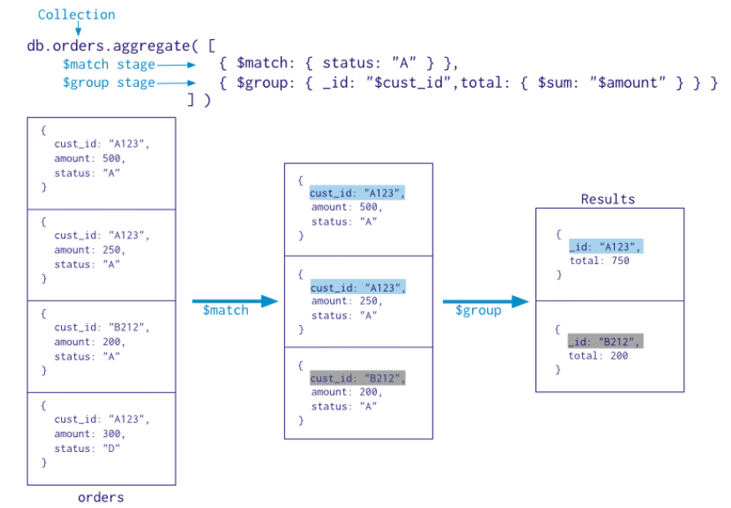
Basic schema of Aggregation Framework

Slide 23
SQL to Aggregation Mapping Chart

Slide 24
More advanced stuff on Aggregation Framework
MongoDB Query Language: What's New (2020-06-10)
https://www.youtube.com/watch?v=iu_DvuIDDUU

Slide 25
Database Modeling in MongoDB
MongoDB Schema Design Best Practices (2020-04)
https://www.youtube.com/watch?v=leNCfU5SYR8
Data Modeling with MongoDB (2020-10)
https://www.youtube.com/watch?v=3GHZd0zv170
A Complete Methodology of Data Modeling for MongoDB (2020-06)
https://www.youtube.com/watch?v=DUCvYbcgGsQ
Advanced Schema Design Patterns (2020-06)
https://www.youtube.com/watch?v=bxw1AkH2aM4
Schema Design Anti-Patterns - Part 1
https://www.youtube.com/watch?v=8CZs-0it9r4

Slide 26
Database Modeling in MongoDB (cont.)
Schema Design Anti-Patterns - Part 2
https://www.youtube.com/watch?v=mHeP5IbozDU
Schema Design Anti-Patterns - Part 3
https://www.youtube.com/watch?v=dAN76_47WtA
Older:
Back to Basics: Schema Design Basics (2019)
https://www.mongodb.com/presentations/back-to-basics-schema-design-basics
Best Practices for Migrating from RDBMS to MongoDB (2019)
https://www.mongodb.com/presentations/best-practices-for-migrating-from-rdbms-to-mongodb

Slide 27
Case study: Sales
Database schema in MongoDB
One-collection version
Super-normalized (relational-like) version
Our solution:
Strengths
Weaknesses
The most important SQL queries "converted"into MongoDB Aggregation Framework queries
See script: 01-05_MongoDB - Case study – Sales.js

Slide 28
Recap: SQL vs MongoDB
SQL to MongoDB Mapping Chart
https://docs.mongodb.org/manual/reference/sql-comparison/

